Slide 1
Predicting Playoff Appearances in NBA
Paul Woodley
Priyanka Prajapati

Slide 2
Project Statement
To determine if there is any correlation with winning correlation with winning, categorized as playoff appearance using the official box score, team box score, player box score from 2012-2018.

Slide 3
Data Selection
Firstly , Selected Choice 2 and then decided topic of basketball
Secondly ,performed a rigorous search on Kaggel
Came up with dataset which includes details of all seasons played between 2012-2018

Slide 4
Need of Preprocessing
Data Size
Data was Huge
Data reduced by average out values in Preprocessing
Many Features
Teamboxscore contain 123 features
Features like Seasontype,GameDate etc were removed in Preprocessing
Different Outcome
Dataset was focused on Game
Outcome which is ‘Playoff’ was focused on season

Slide 5
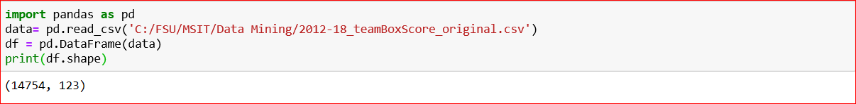
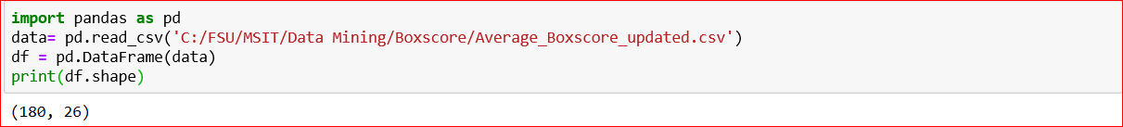
Dataset Preprocessing
Before Preprocessing
After Preprocessing

Slide 6
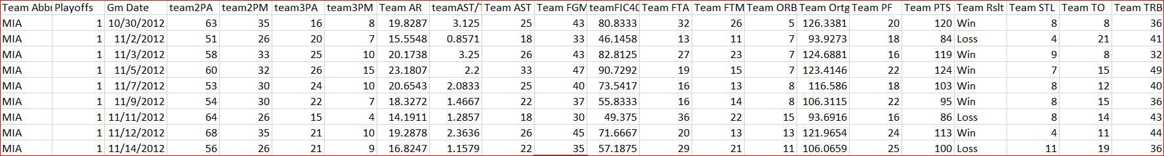
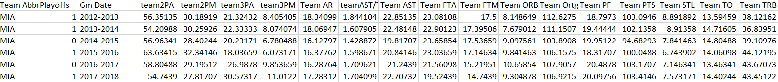
Result of Preprocessing
Because main focus was team ,averaged out all team data for single season,removed unnecessary columns and created a new dataset
Data Before Preprocessing
Data After Preprocessing

Slide 7
Model Implementation-Python
Used Python for implementing models like Decision Tree, Random Forest, Logistics Algorithm and Support Vector Machine
Used Jupyter notebook and Spyder for code implementation
 | Decision Tree | Logistics Regression | SVM | Random Forest
Accuracy | 75% | 91.67% | 72.23% | 66.67%

Slide 8
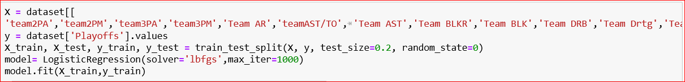
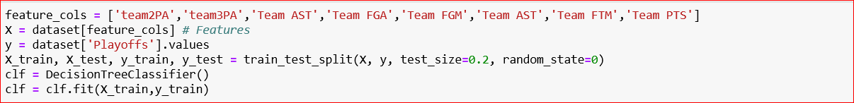
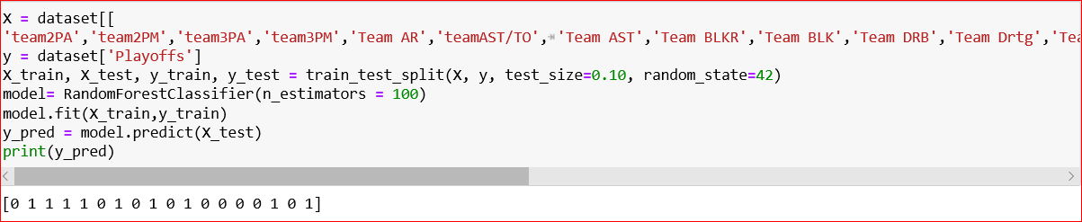
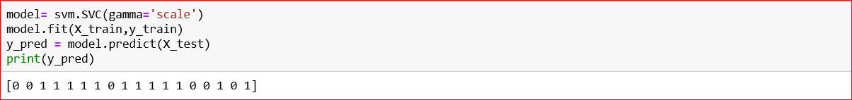
Model implementation -Python
LR
Decision Tree
Random Forest
SVM

Slide 9
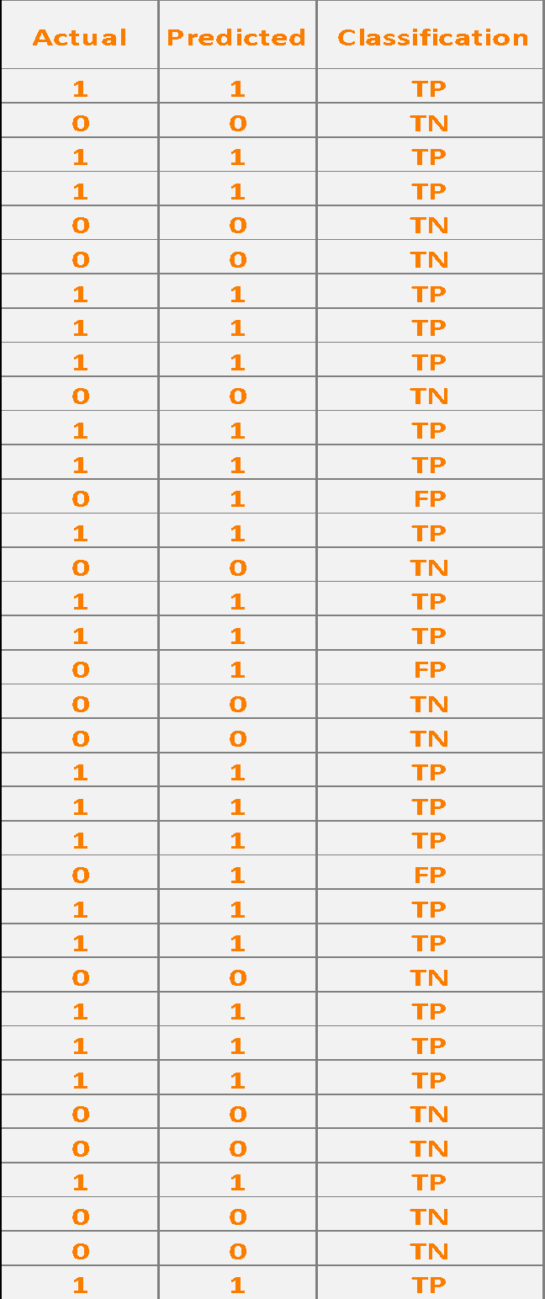
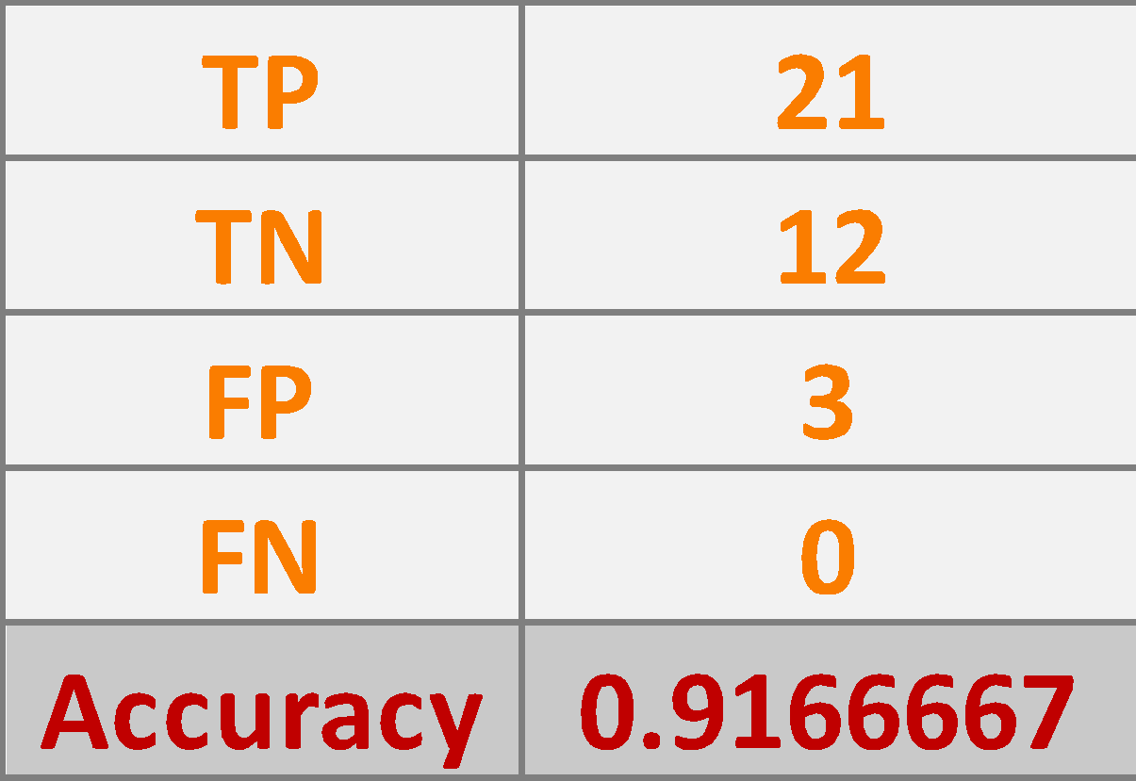
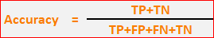
Manual Calculation in Excel(Logistic Regression)
Model Accuracy

Slide 10
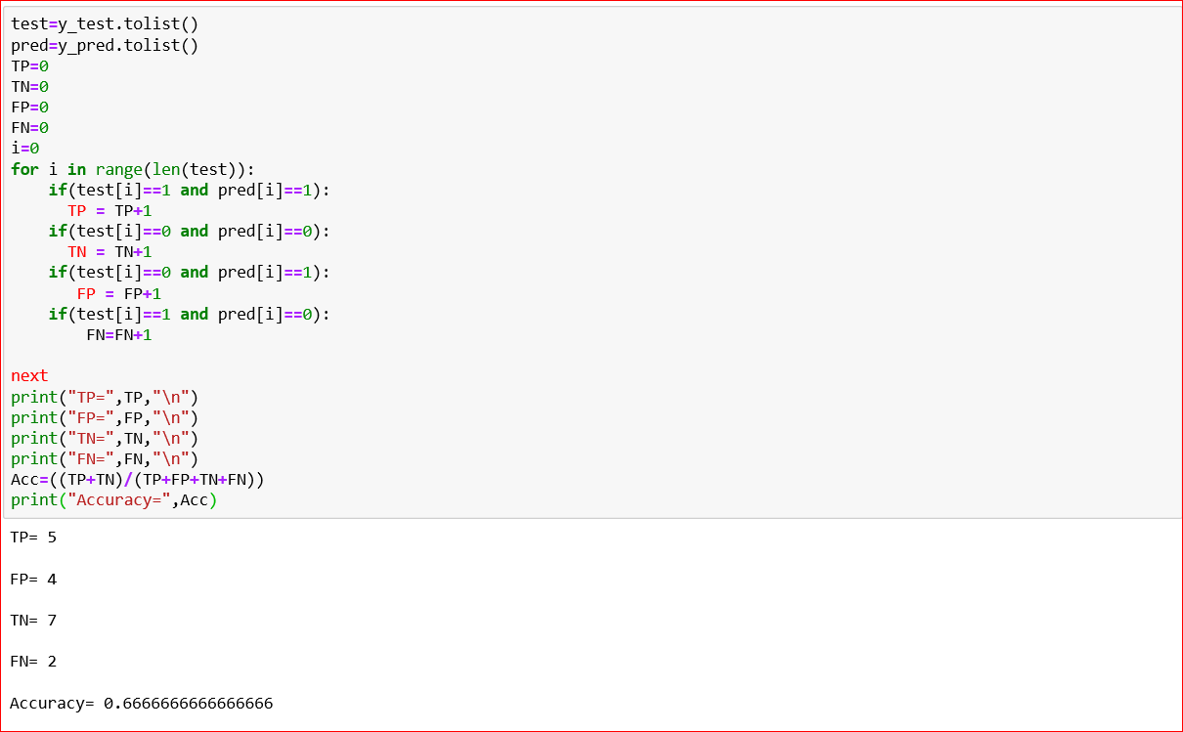
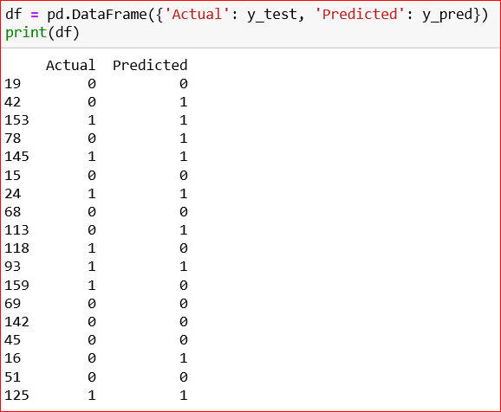
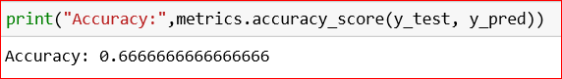
Manual verification of accuracy using code for Random Forest

Slide 11
Model Performance -Python
Model | Precision | Recall | f-score
Logistics Regression | 0.938 | 0.900 | 0.911
Random Forest | 0.738 | 0.747 | 0.721
SVM | 0.792 | 0.773 | 0.721
Decision Tree | 0.744 | 0.748 | 0.745

Slide 12
Model Implementation - Orange
Model | Precision | Recall | f-score
Naive Bayes | 0.741 | 0.739 | 0.739
Random Forest | 0.822 | 0.823 | 0.822
SVM | 0.807 | 0.806 | 0.805
Decision Tree | 0.739 | 0.739 | 0.739

Slide 13
Model Implementation - Weka
Model | Precision | Recall | f-score
Naive Bayes | 0.767 | 0.767 | 0.766
Random Forest | 0.696 | 0.611 | 0.547
Decision Tree | X | X | X

Slide 14
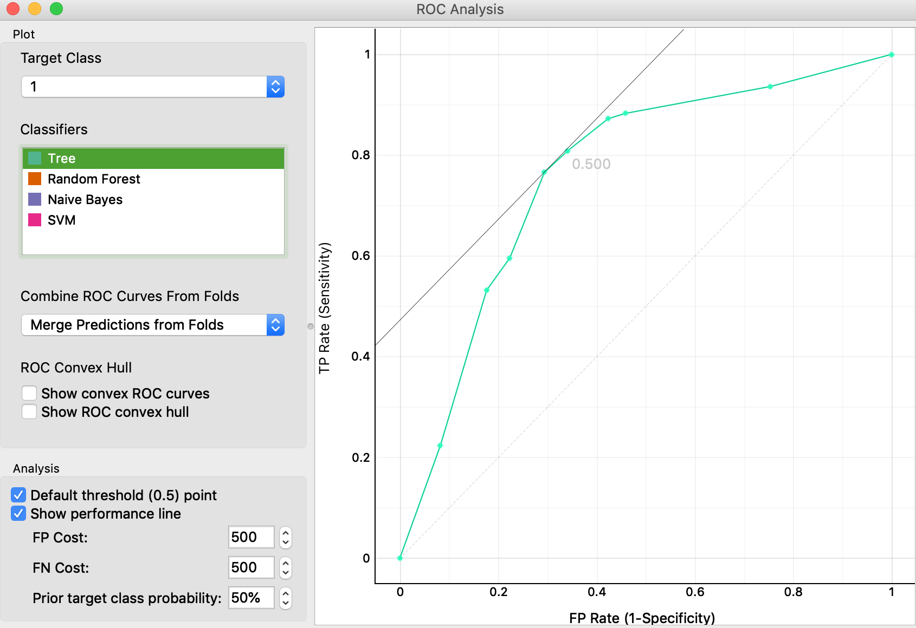
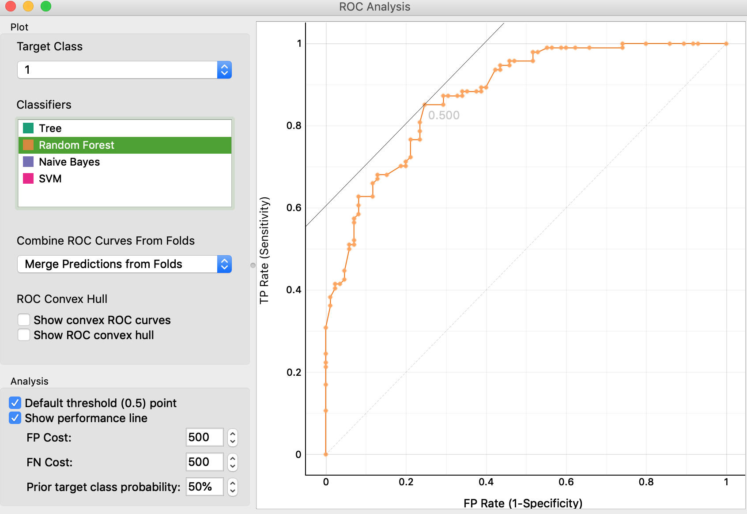
ROC Analysis
Predicted Playoff Appearance
J48 Tree
Random Forest

Slide 15
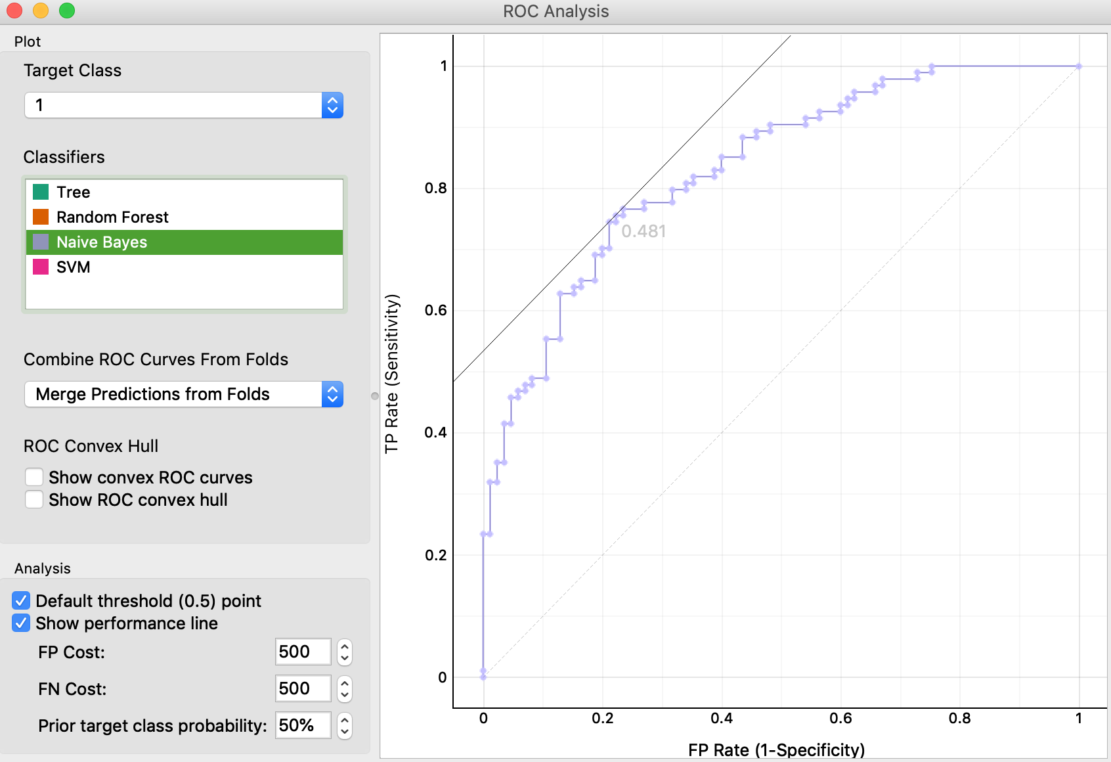
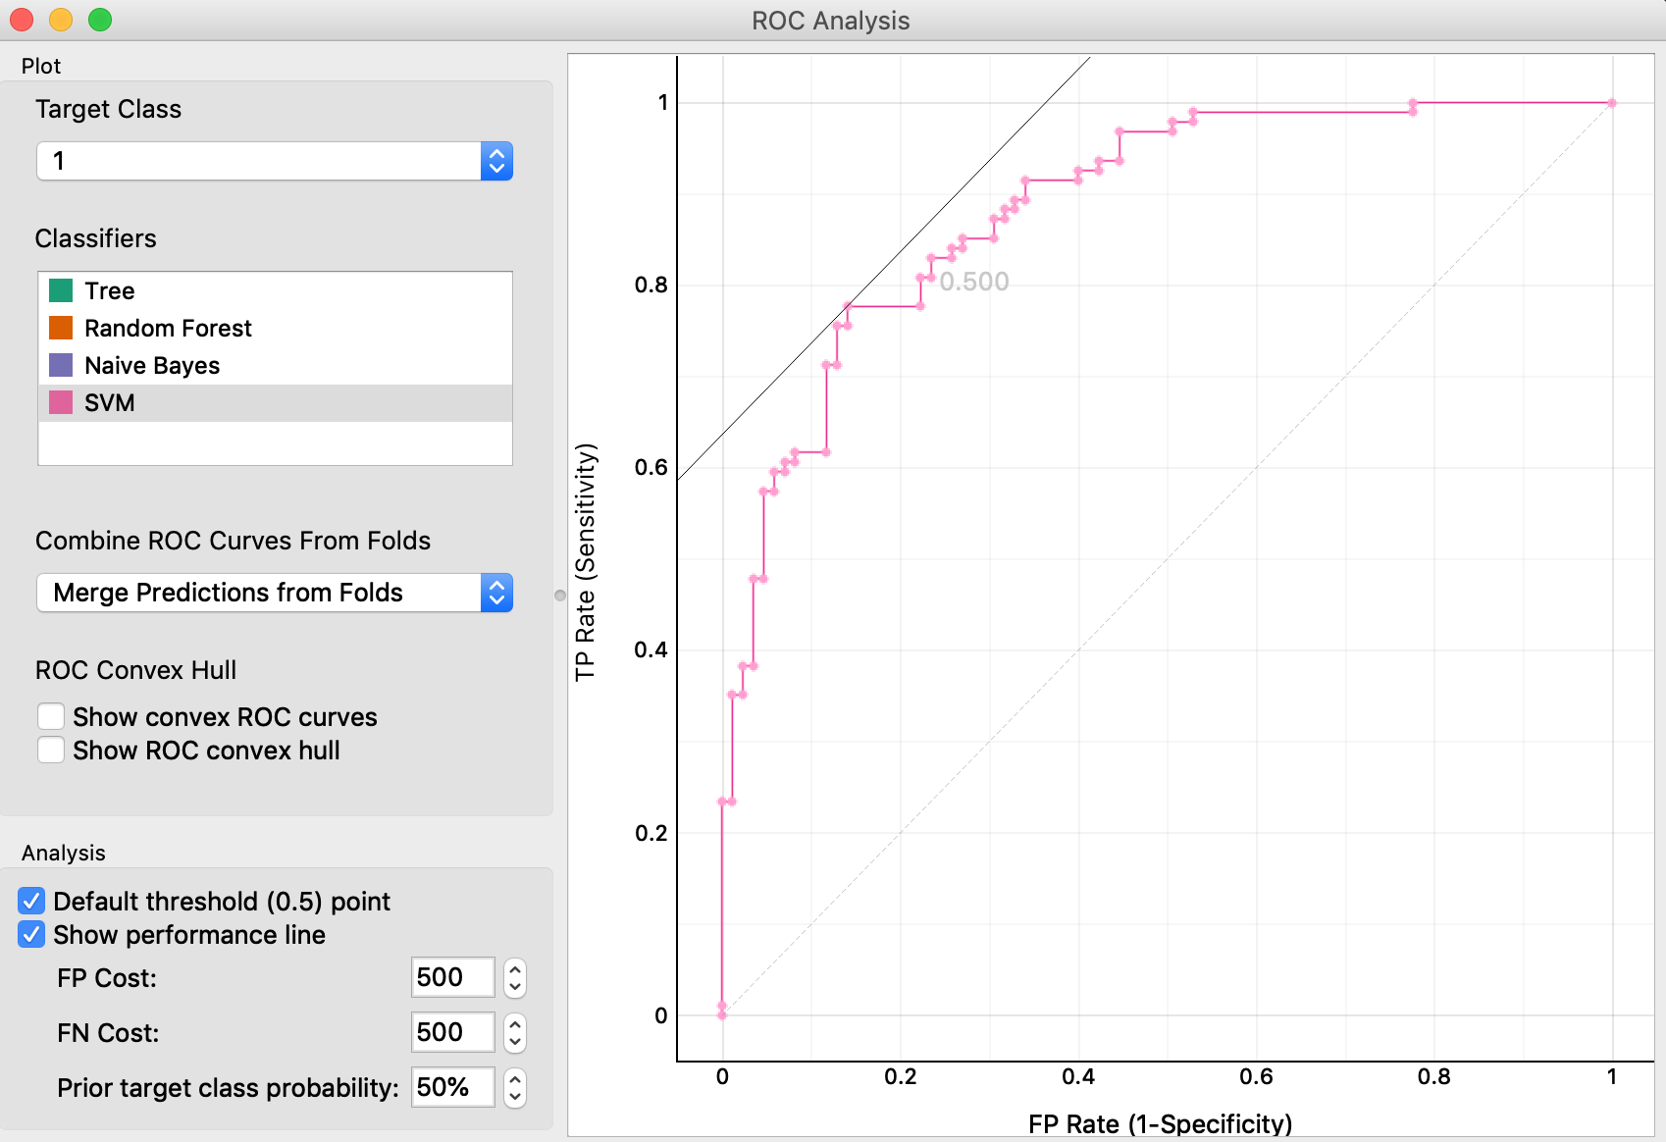
ROC Analysis
Predicted Playoff Appearance
Naive Bayes
SVM

Slide 16
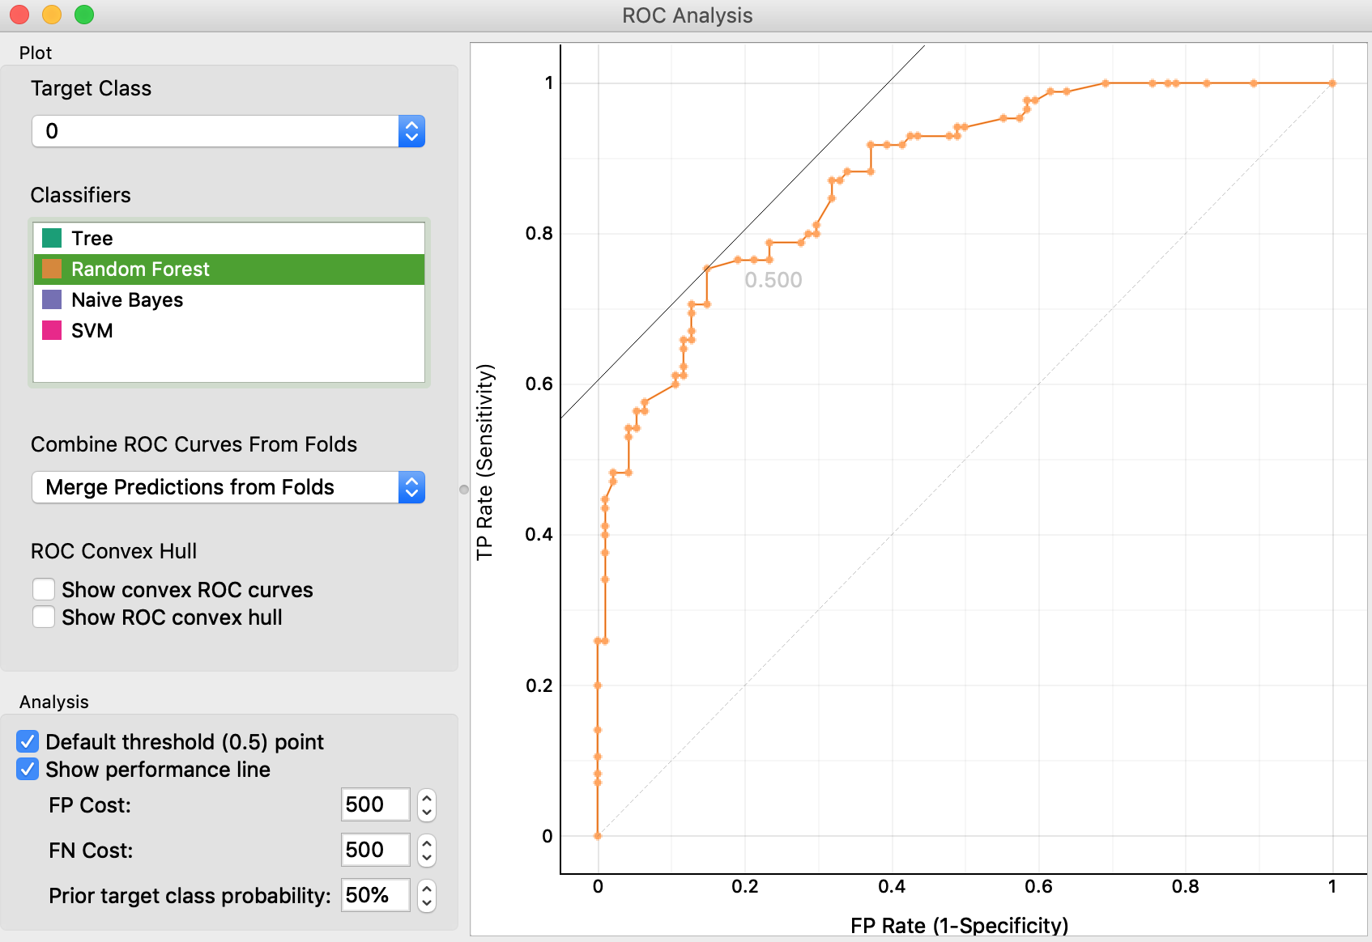
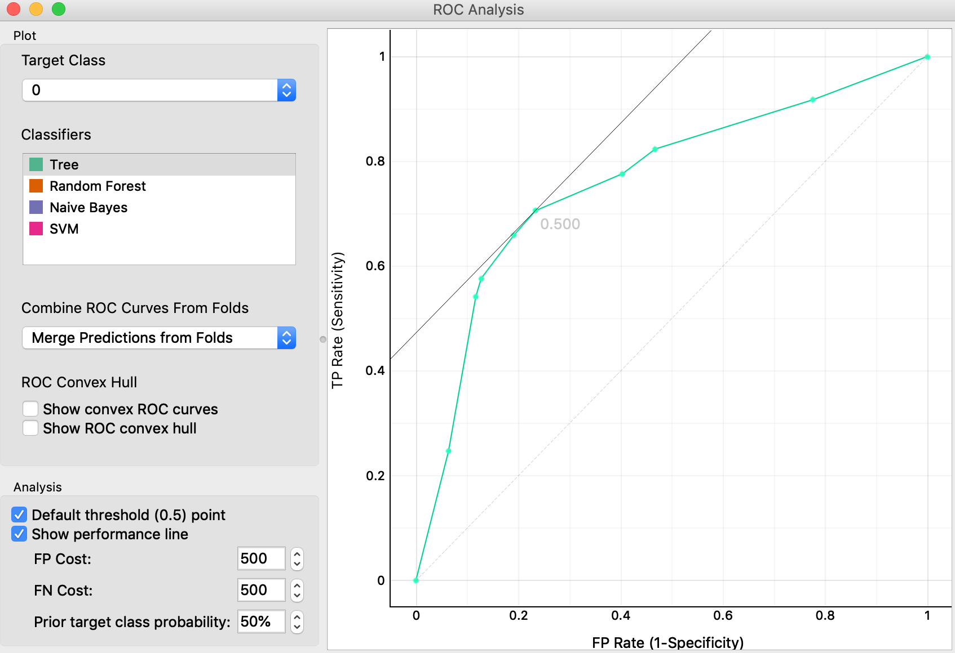
ROC Analysis
Predicted No Playoff Appearance
J48 Tree
Random Forest

Slide 17

ROC Analysis
Predicted No Playoff Appearance
Naive Bayes
SVM

Slide 18
Conclusion
Only model logistic regression proved to be the most accurate with 91.67% accuracy and 91.1% f-score while other models proved to be mediocre as the accuracy of the predictions are not ideal.
The random forest classification had the precision, at 75.6%. This is the amount of instances predicted correctly, TP, out of all of the predictions predicted true.
Both the Random Forest and Naive Bayes had the same recall percentage at 76.5%. This amount comes from the amount of instance predicted correctly divided by the actual true instances.
The variables with the highest significance include:
Team 2PA- 2 Pointers Attempted
Team 3PA- 3 Pointers Attempted
Team AR- Team Assist Rate
Team AST/T0- Team Assist to Turnover ratio
Team BLKR- Team Block percentage

Slide 19
Questions?

